Slide 1

Clustering of Paris neighborhoods
FROM AN ARTISTIC OFFER POINT OF VIEW
Coursera - Capstone project
A. CAJA

Slide 2

Table of Contents
Introduction
Data
Methodology
Results
Discussion
Conclusion

Slide 3

Introduction
This project aims to cluster neighborhoods in Paris using criteria related to art.
It could be useful for at least two reasons :
for people who know they like a neighborhood and would like to discover other neighborhoods which offer the same artistic activities.
for launching new businesses like music venues or art galleries. The clustering helps them identify
the neighborhoods where the offer is large, which also means that people go to these neighborhoods because they expect to find these kind of activities.
the neighborhoods where the offer is more limited where it could also be interesting to invest and increase the offer and find new customers.

Slide 4
Data
Data sources :
GEOJSON file of Paris neighborhoods :
- to make FourSquare search queries based on the neighbourhood corrdinates;
- to respresent the neighbourhoods clustering in a map.
Data from Foursquare :
- venue categories identification numbers in order to make queries
- number of museums, art galleries, opera houses, concert halls, etc for each city in the list.

Slide 5
Data used after cleaning and preparing : number of art venues for each neighborhood >>>>

Slide 6
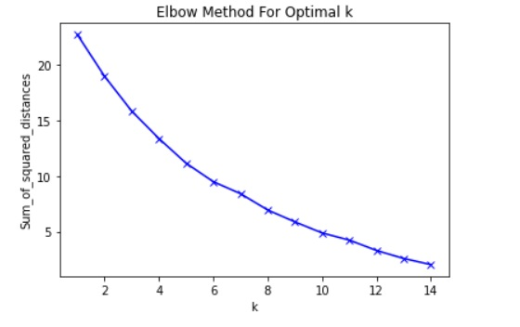
Methodology
We will use clustering algorithms in order to find neighborhoods of Paris which artistic offer looks alike.
First we transform data with a MinMax scaler in order for the variables used to be of equal importance. We perform a KMeans algorithm in order to fit the data.
Second in order to find the optimal number of clusters we use the Elbow method. As we can see in the following image, the gain in the sum of distances function, decreases more slowly after 6 clusters.
Hence, we will perform
a KMeans algorithm with
6 clusters.

Slide 7

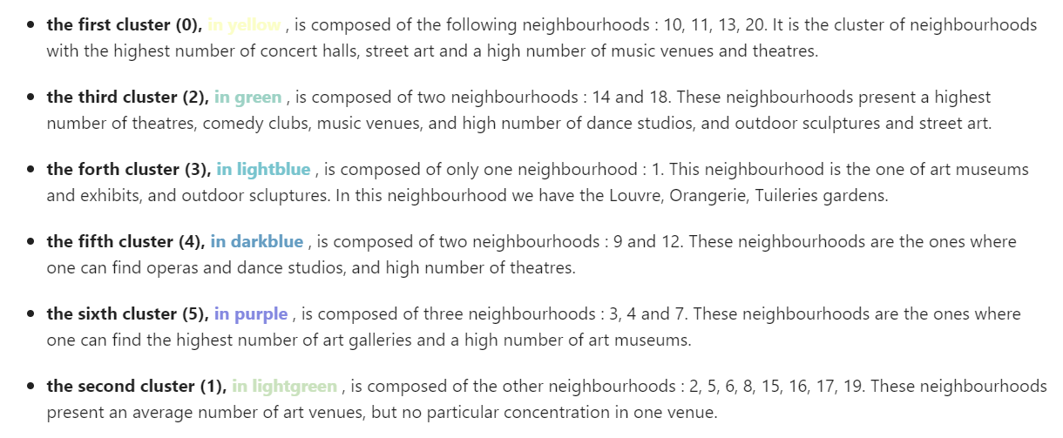
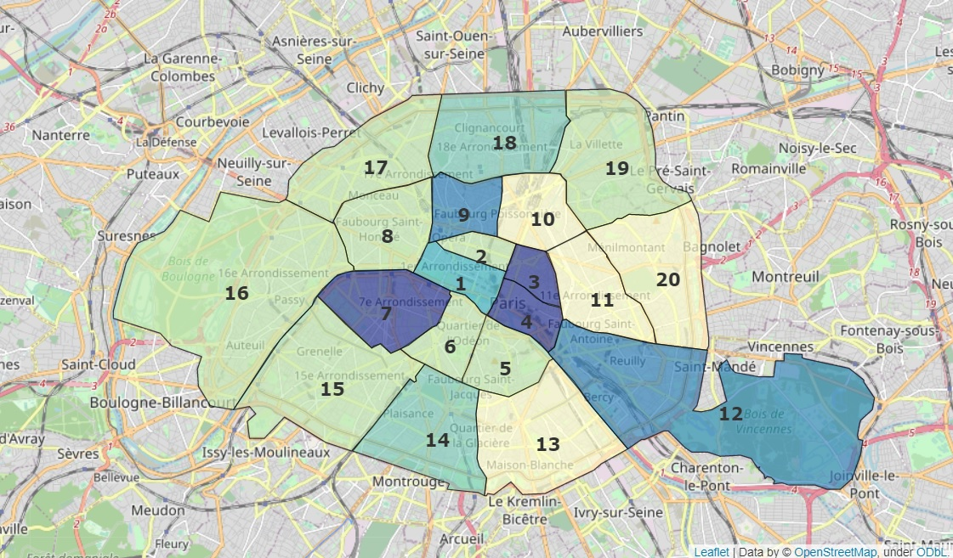
Results

Slide 8
Discussion
Based on the results, people who know they like a neighborhood or the neighborhood they live in, let's say the 11th ring of Paris because of the large offer of concerts, can decide to visit or to live in the 10th, 13th and 20th neighborhoods of Paris if this criterion is important to them.
An investor who would like to open an art gallery could decide to do so in the 3, 4, 7 neighborhoods that people visit among other thing because of the high concentration in art galleries, or to develop art galleries in the 9th or 12th neighborhoods where their number is not high.
However, data used for the study are not exhaustive because of art venues which do not have any associated neighborhood information in FourSquare. Another study should be done with all the data available.

Slide 9
Conclusion
This study aimed to identify clusters of Paris neighborhoods based on their art offer. Different categories of art categories were chosen, mostly art museums, theatres, opera houses, etc. 6 clusters were identified representing neighborhoods with a high number of particular venues in them.
However, cinemas or other types of artistic places, were not included in the study. It would be interesting to see how they would influence clustering.
As discussed in the previous section, all art venues did not include information about the neighborhood they are in. It would thus be of interest to perform the study with those venues in the data set.
It would also be interesting to check the results other types of clustering algorithms would give.

